Slide 1
Spring Core
Presenter
huylq33 (host)
ducvm10
hungmb
toanhv22
Notes:
Huy (Toàn bộ phần lý thuyết, tuy nhiên trong quá trình present có thể gọi đồng đội lên present hộ)
Đức (Demo)
Các kiểu configuration (XML, annotation)
Các kiểu inject (constructor, setter, field)
Hưng (Demo)
BeanFactory và ApplicationContext
Bean lifecycle và scope, lazy-init
BeanPostProcessor
Toàn (Demo)
@Conditional
Profiles và Environments

Slide 2
Content
Some Concepts (Framework, Library, IoC)
Spring Framework
Introduction to Spring Framework (Definition, history, architecture, feature)
Spring-core (DI, IoC Container, BeanFactory, ApplicationContext)
Spring Bean (POJO, Spring Bean, Bean Scope, Bean Lifecycle)
BeanPostProcessor
Profiles And Environments
@Conditional Bean
Demo
Notes:
Phần 1 (15 mins): Giới thiệu khái niệm framework, library, IoC
Framework là gì? Library là gì?
Sự khác biệt giữa cách sử dụng của framework và library thể hiện thông qua cách người sử dụng điều khiển luồng hoạt động của chương trình → Inversion of Control
Phần 2 (90 mins) Tổng quan spring framework trước → Đi sâu vào cơ chế cốt lõi của module spring-core là IoC Container → Các khái niệm liên quan đến Spring bean
Spring Framework là gì, why use? Lịch sử, feature, architecture (10 - 15 mins)
DI pattern → cách implement DI trong Spring → IoC Container (Phân biệt BeanFactory và ApplicationContext) (20 mins sơ lược lý thuyết, đi sâu hơn lúc demo)
Các instance được quản lý bởi IoC container → Spring bean (Phân biệt POJO và Spring bean) (10 mins)
IoC quản lý bean → Bean Scope (Khi nào tạo bean khi nào hủy bean) → Bean Lifecycle (Quá trình sinh ra chết đi như nào) (15 mins)
Cho phép can thiệp vào lifecycle của bean → BeanPostProcessor (10 mins)
Cho phép tạo bean tùy theo điều kiện → @Conditional và @Profile (Phân biệt 2 thằng này) (10 mins)

Slide 3
What is Framework?
In general, framework is a real or conceptual structure intended to serve as a support or guide for the building of something that expands the structure into something useful.
Software framework: tool/software/platform/environment which has pre-defined code to support developing software applications

Slide 4
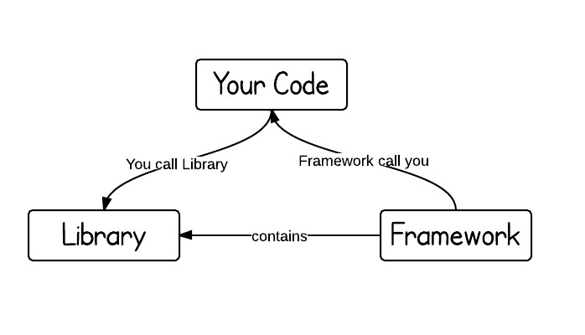
Framework vs library
Traditional: main function calls libraries → We control flow of program
Framework: when/where/how our code get called? → We cannot control flow of our program

Slide 5
Spring Framework
Open source Java platform that provides comprehensive infrastructure support for developing Java-based enterprise applications
Spring handles the infrastructure so you can focus on your application:
Make a Java method execute in a database transaction without having to deal with transaction APIs
Make a local Java method a remote procedure without having to deal with remote APIs
Make a local Java method a management operation without having to deal with JMX APIs
Make a local Java method a message handler without having to deal with JMS APIs

Slide 6
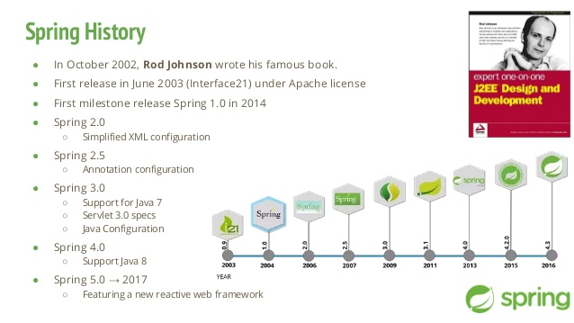
Spring Framework History
Notes:
Spring ra đời năm 2003 do J2EE quá phức tạp
Phát triển trên những tinh hoa của Java EE

Slide 7
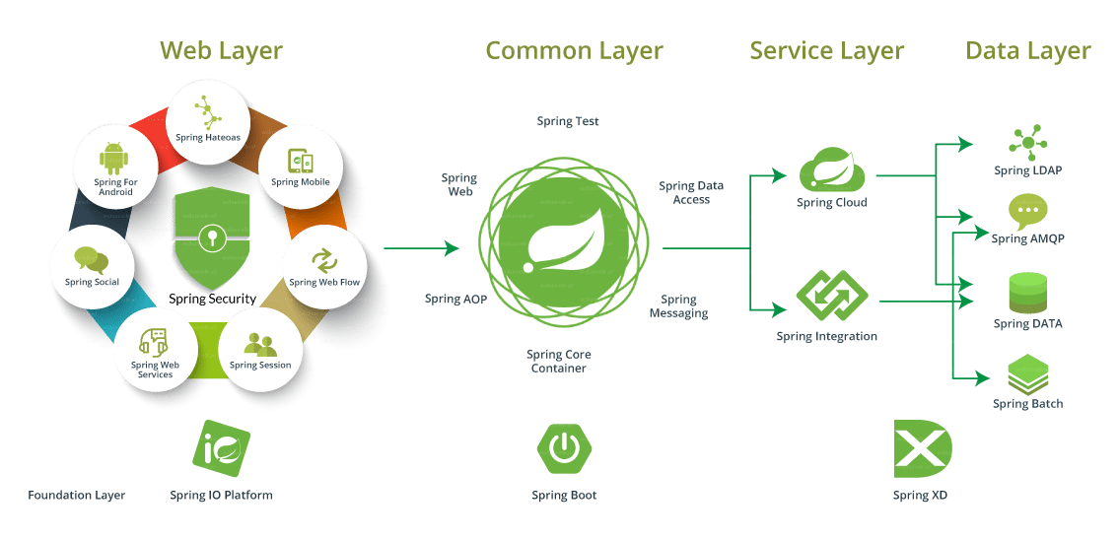
Spring Framework Ecosystem
Notes:
Ngoài Spring Framework còn có những project khác (Spring Boot, Spring Data, Spring Cloud, Spring Batch) phục vụ cho các layer khác nhau của application. Tất cả project được gói trong hệ sinh thái của Spring nhưng bản thân chúng vẫn là project riêng biệt (source code repo riêng, release hay issue tracker riêng) (Ví dụ Xuất nhập khẩu là công ty độc lập nhưng vẫn thuộc quản lý của tập đoàn Viettel)

Slide 8
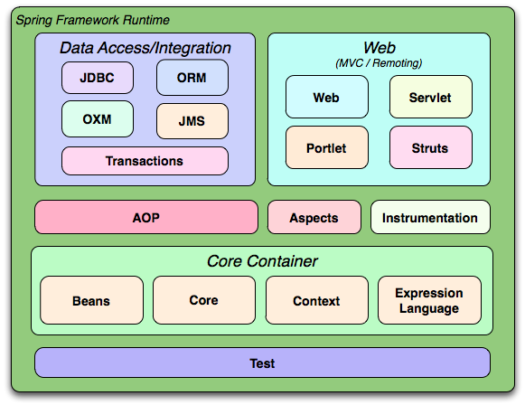
Spring Framework Modular architecture
Spring Framework is divided into modules → Applications can choose which modules they need
At the heart are the modules of the core container, including configuration model and dependency injection mechanism

Slide 9
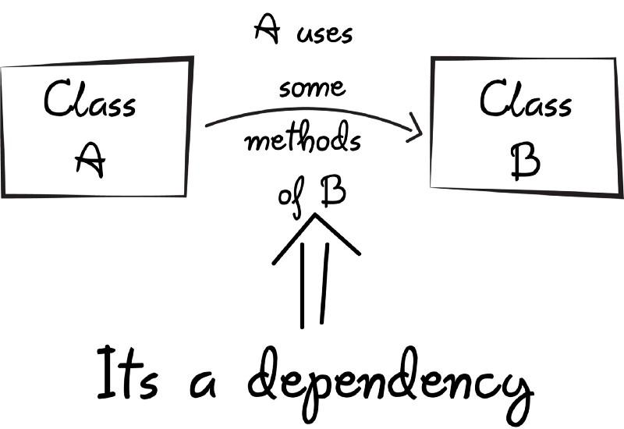
Dependency injection
Class A (Client) uses class B (Service)
Where to find class B?
How to construct class B?
Notes:
A dùng B → Cách đơn giản nhất là composition (A chứa B) → Khởi tạo trực tiếp B trong A → Tight coupling (A cần biết logic khởi tạo B, thay đổi cách khởi tạo B là phải thay đổi A, mỗi lần khởi tạo A là khởi tạo B, hủy A là hủy luôn B,...)
→ Không khởi tạo trực tiếp B trong A nữa → Khởi tạo B ở ngoài rồi truyền (inject) vào A thông qua constructor hoặc setter → Loose coupling (A không cần biết logic khởi tạo của B, nếu B là interface thì A cũng không cần biết implementation nào của B được sử dụng, inject một B vào nhiều A,...)

Slide 10
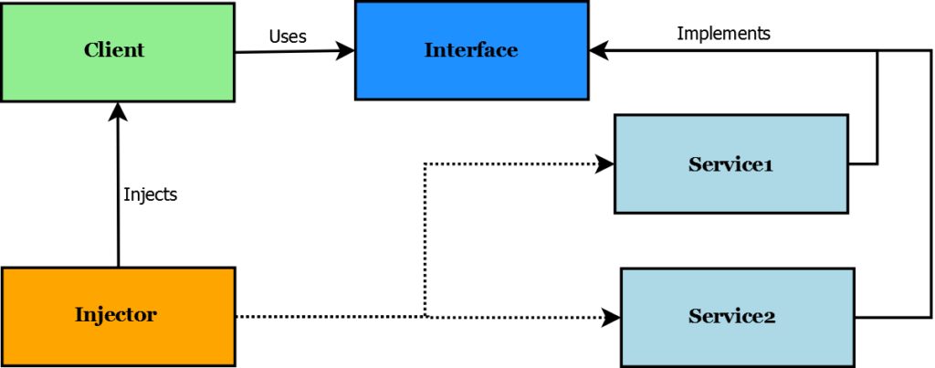
Dependency Injection
Dependency Injection: design pattern follows IoC principle
Components:
Client
Service
Interface
Injector
Notes:
Client sử dụng các Service dưới dạng Interface
Injector tìm hoặc khởi tạo Service và inject vào client thông qua constructor hoặc setter
→ Client không cần quan tâm service nào đang được sử dụng, service được lấy ở đâu hoặc tạo ra sao, lưu ở đâu, bao giờ thì mất, service này có cần dùng service khác không; client cũng không quan tâm ai là injector

Slide 11
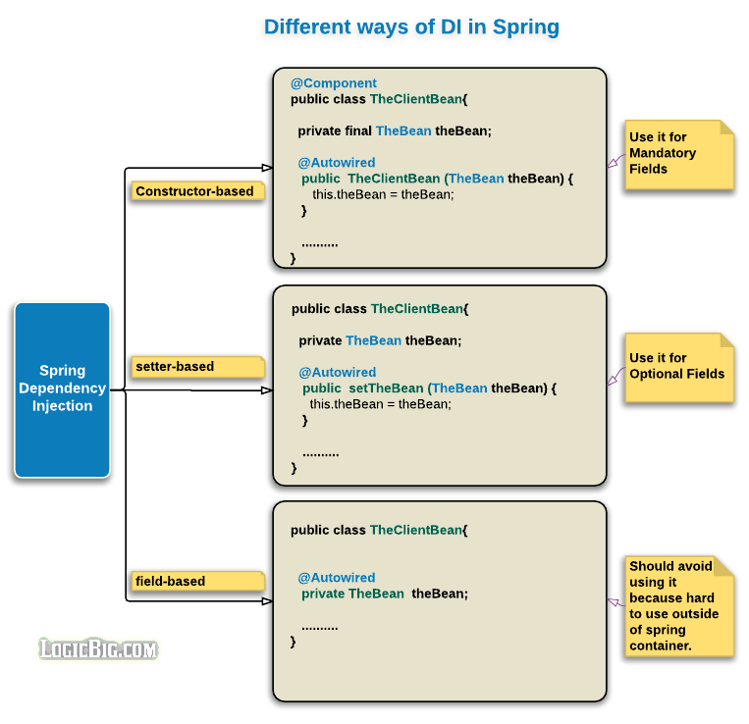
Dependency Injection In Spring
3 ways: constructor, setter, field
Recommend: constructor, setter
Should avoid field injection: hard to test, tight coupling with DI container, dependencies are hidden from outside
Notes:
Field injection drawbacks
The reasons why field injection is frowned upon are as follows:
You cannot create immutable objects, as you can with constructor injection
Your classes have tight coupling with your DI container and cannot be used outside of it
Your classes cannot be instantiated (for example in unit tests) without reflection. You need the DI container to instantiate them, which makes your tests more like integration tests
Your real dependencies are hidden from the outside and are not reflected in your interface (either constructors or methods)
It is really easy to have like ten dependencies. If you were using constructor injection, you would have a constructor with ten arguments, which would signal that something is fishy. But you can add injected fields using field injection indefinitely. Having too many dependencies is a red flag that the class usually does more than one thing, and that it may violate the Single Responsibility Principle.

Slide 12
IoC Container
Framework implements automatic DI, manage object’s creation, lifetime, injects dependencies into object
Create object of specified class, inject dependencies through constructor, method, property at runtime and dispose object at appropriate time
Provide support for DI lifecycle:
Register: which dependency to instantiate
Resolve: IoC container creates objects for us
Dispose: manage lifetime of objects
Notes:
Register: The container must know which dependency to instantiate when it encounters a particular type. This process is called registration. Basically, it must include some way to register type-mapping.
Resolve: When using the IoC container, we don't need to create objects manually. The container does it for us. This is called resolution. The container must include some methods to resolve the specified type; the container creates an object of the specified type, injects the required dependencies if any and returns the object.
Dispose: The container must manage the lifetime of the dependent objects. Most IoC containers include different lifetime managers to manage an object's lifecycle and dispose it.

Slide 13
IoC Container in Spring
Interface ApplicationContext represents the Spring IoC container and is responsible for instantiating, configuring, and assembling beans.
The container gets its instructions on what objects to instantiate, configure, and assemble by reading configuration metadata.
The configuration metadata is represented in XML, Java annotations, or Java code.

Slide 14
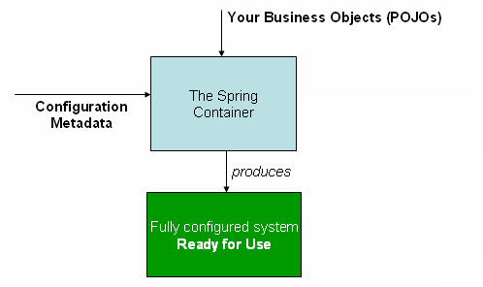
IoC Container in Spring
IoC Container: BeanFactory/ApplicationContext
Metadata: id, dependencies, scope,...
Configuration: XML, annotation
Instances managed by IoC Container: Spring Bean

Slide 15
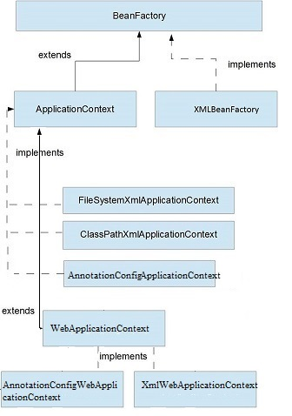
BeanFactory & Application Context
Both are interface
ApplicationContext extends BeanFactory and provides more features (annotation-based DI, i18n, eager-loading,...)

Slide 16
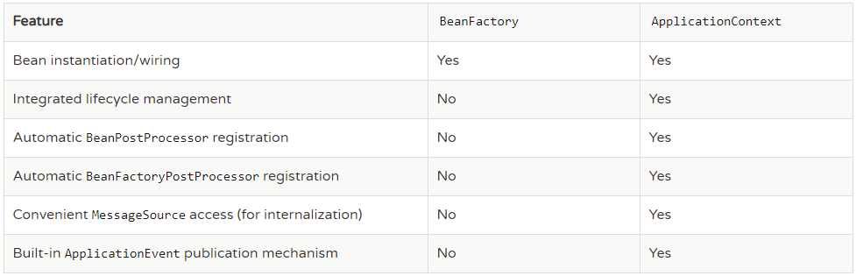
BeanFactory & Application Context

Slide 17
Configuration Metadata
IoC Container uses metadata to create bean
Ways to config metadata:
XML configuration
Java-based configuration
Annotation configuration

Slide 18
POJO vs Spring Bean
POJO (Plain Old Java Object): ordinary Java objects, not bound by any special restrictions
Java Beans: they are serializable, have a zero-argument constructor, and allow access to properties using getter and setter methods
Spring Beans: POJO + Metadata (id, scope, dependencies,...) and managed by Spring IoC Container

Slide 19
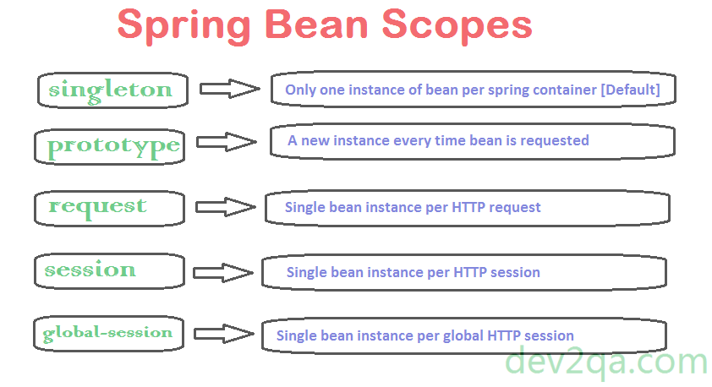
Spring Bean scope
Notes:
3 scope dưới sử dụng cho các ứng dụng web → Không trình bày
Singleton: một instance duy nhất
Prototype: mỗi request một instance

Slide 20
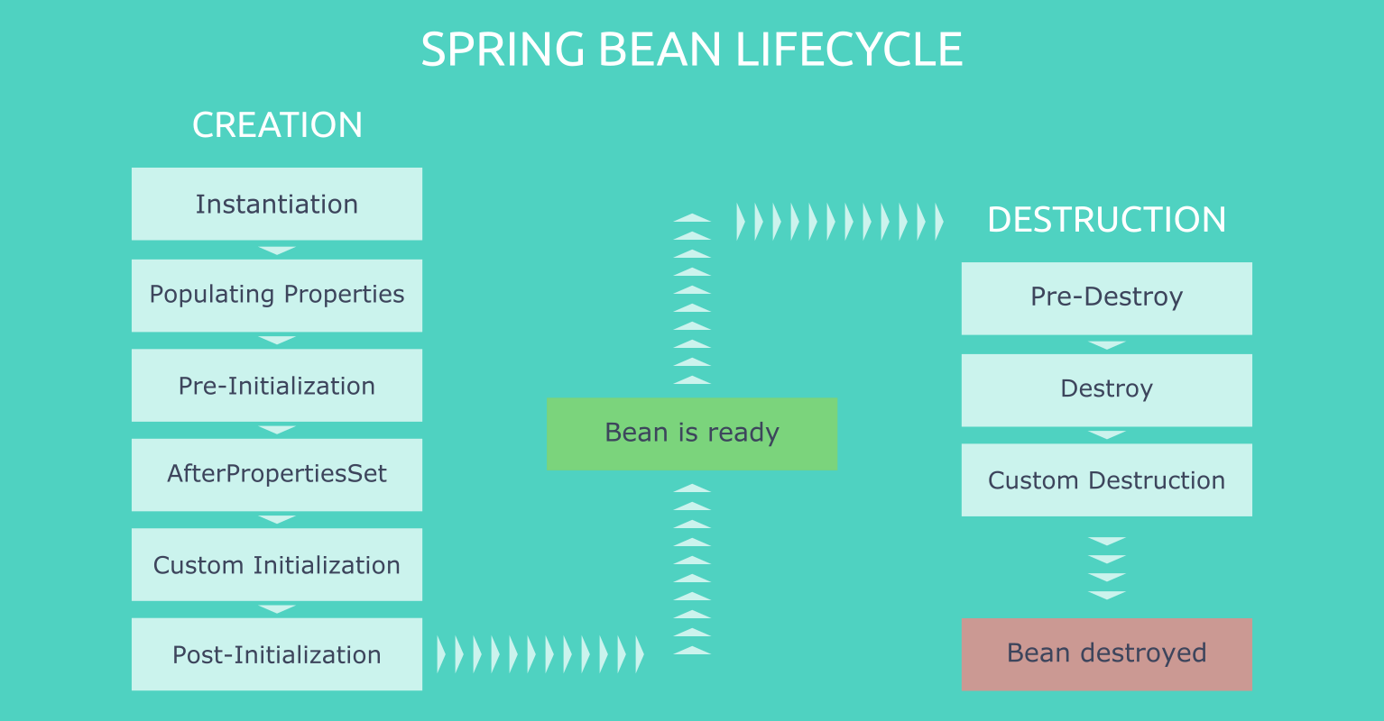
Spring Bean lifecycle
Notes:
Instantiation: Create Bean and load into IoC Container
Populating properties: IoC Container create id, scope, default values based on bean definition
Pre-Init/AfterPropertiesSet/Custom Init/Post-Init: Custom init
Bean is ready: bean is created and injected all dependencies, as well as all custom init
Pre-Destroy/Destroy/Custom Destruction: custom destroy
Bean destroyed: Bean will be removed or destroyed from IoC Container and JVM memory

Slide 21
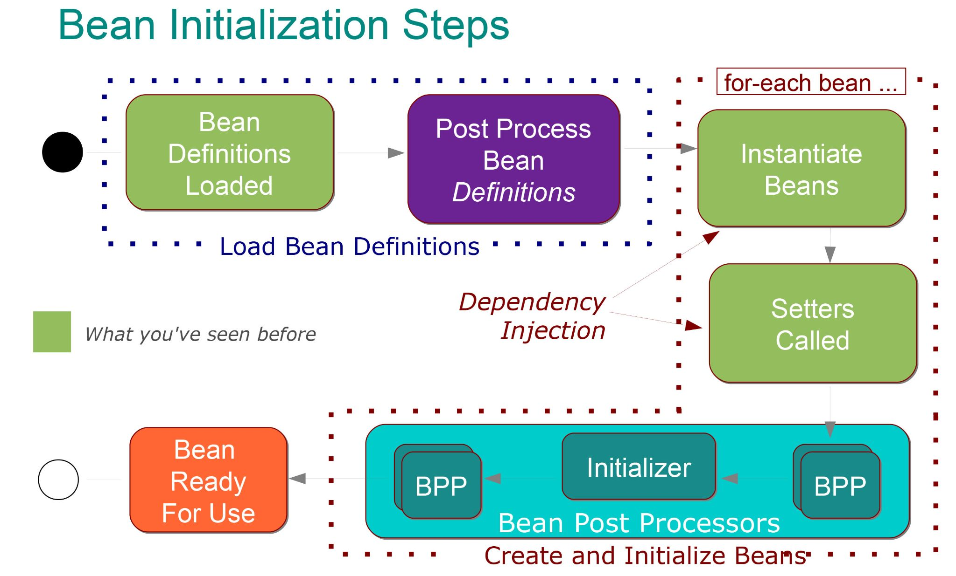
BeanPostProcessor

Slide 22
Profiles and Environments
Spring 3.1
@Profile annotation
“If-Then-Else” conditional checking for bean registration

Slide 23
@Conditional Bean
Spring 4
Generalized version of @Profile
User-defined strategies for conditional checking via Condition interface

Slide 24
Demo

